Slide 1
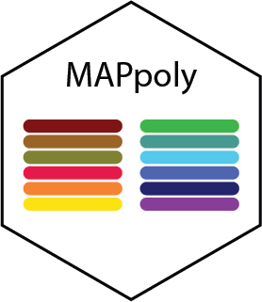
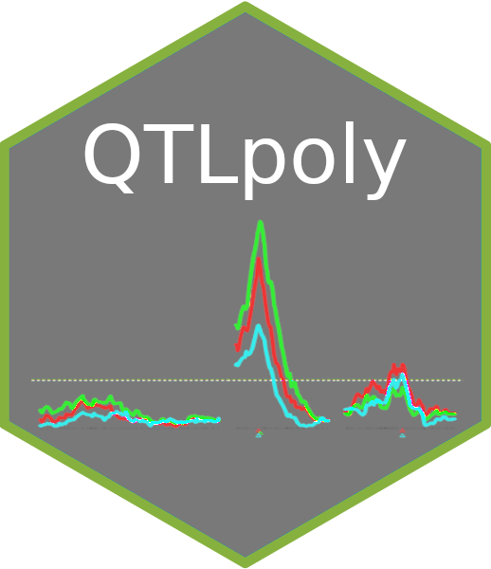

MAPpoly and QTLpoly updates
Marcelo Mollinari
Gabriel Gesteira
Guilherme Pereira
Zhao-Bang Zeng

Slide 2
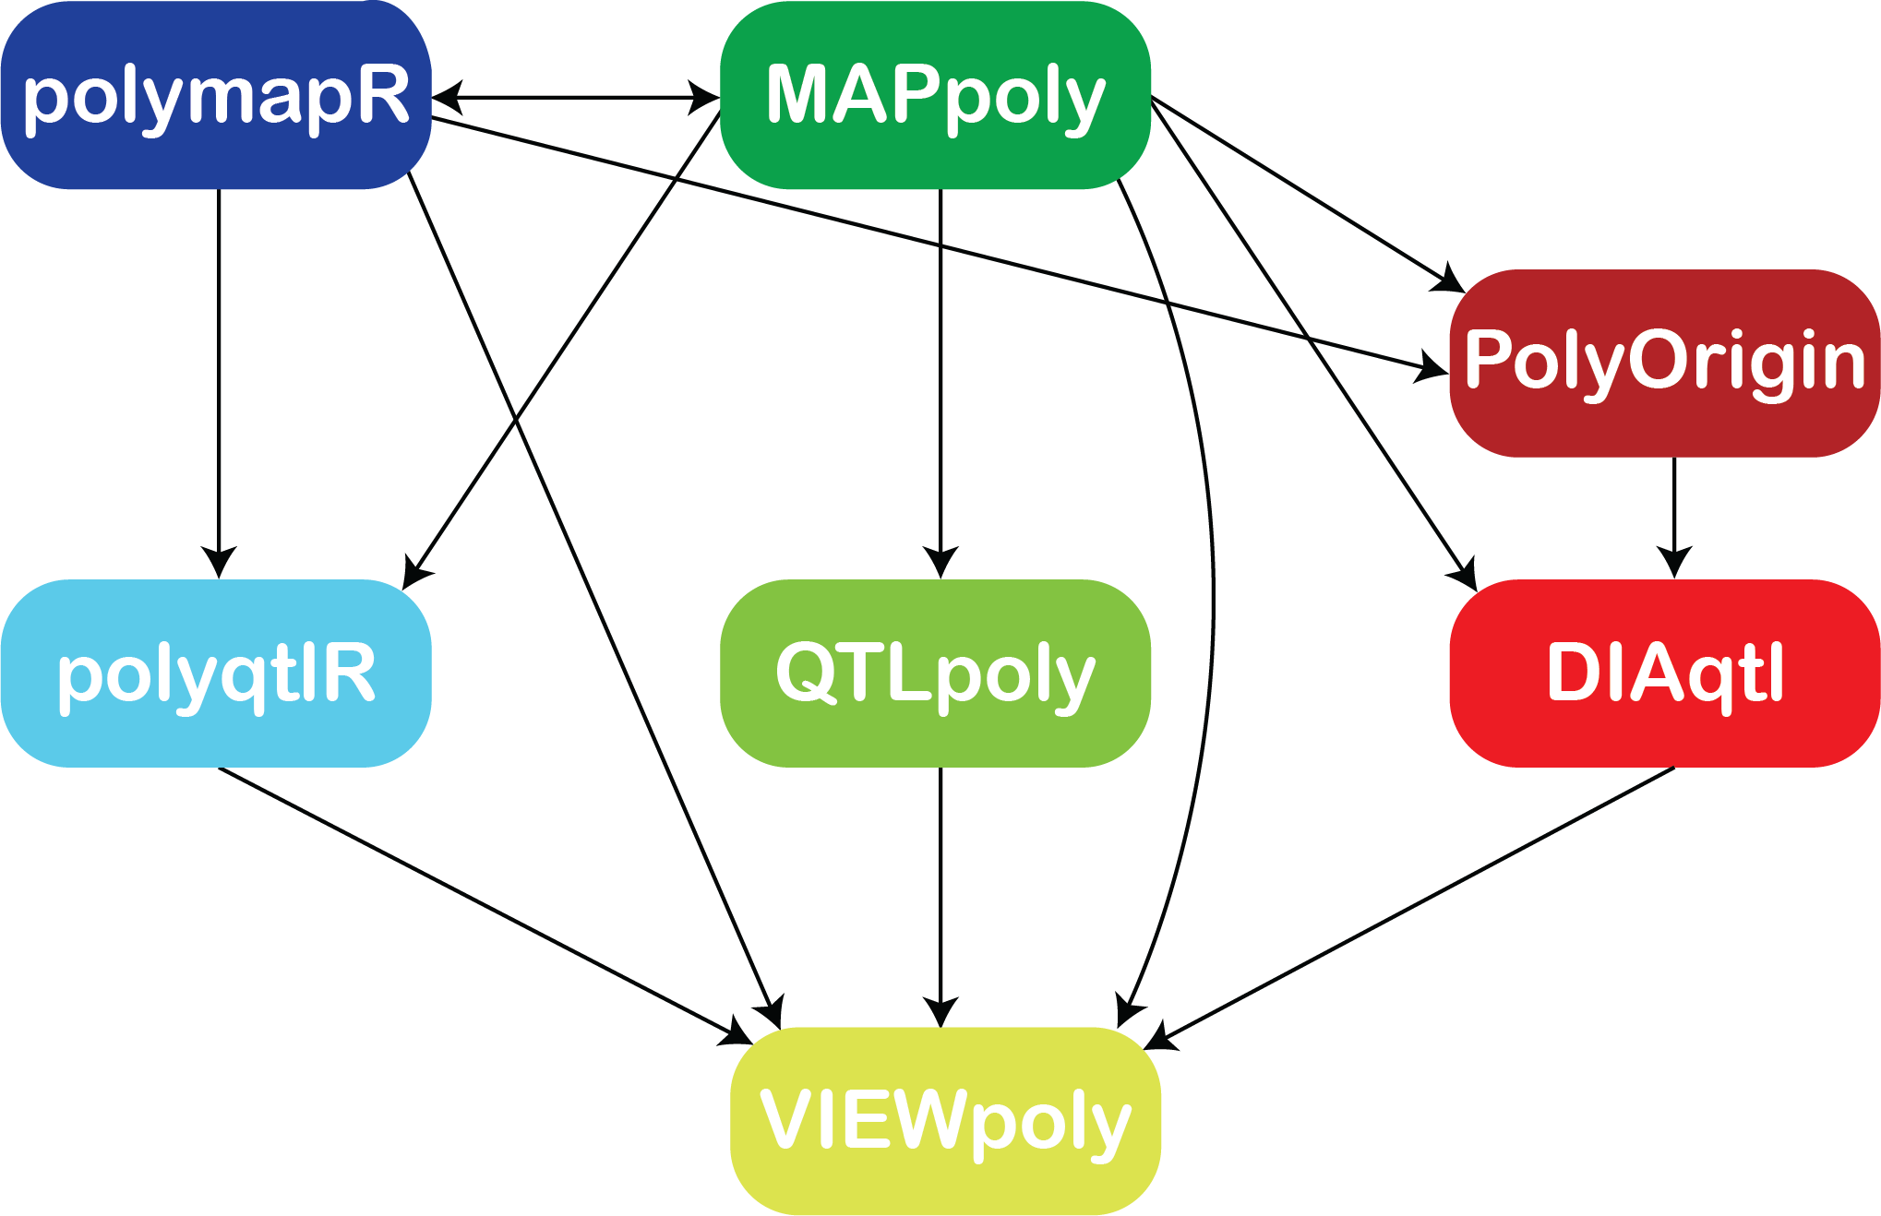
Analytical environment for linkage and QTL analysis in polyploids

Slide 3
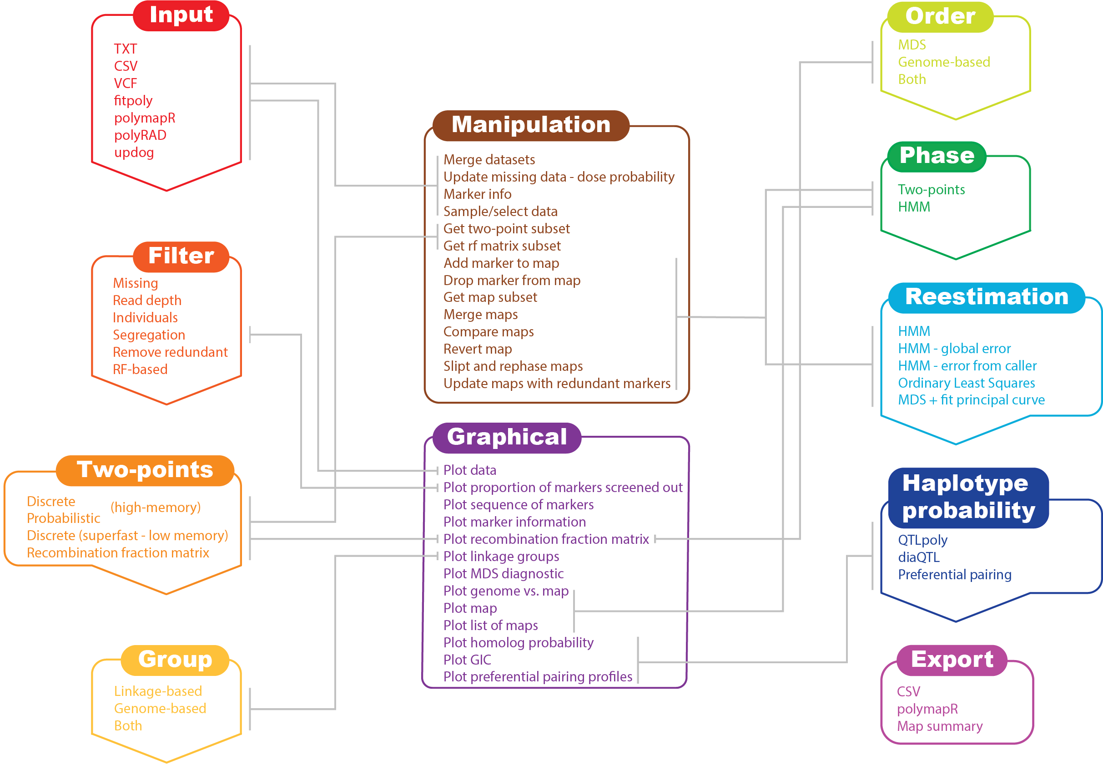
MAPpoly workflow

Slide 4
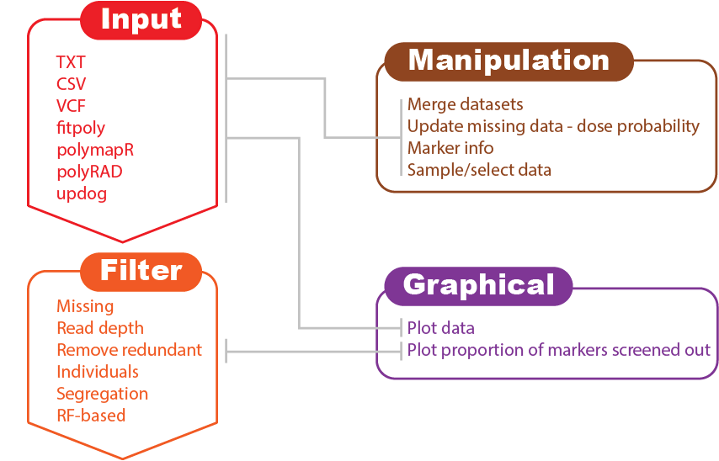
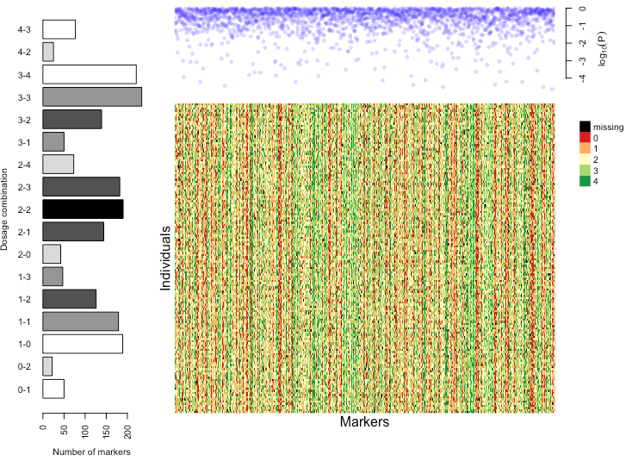
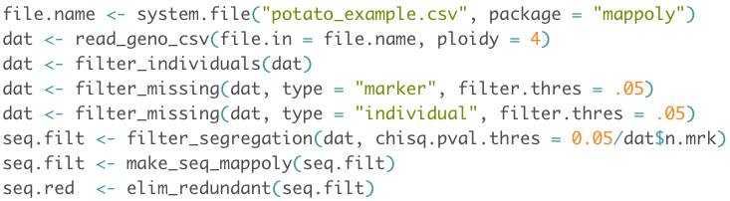
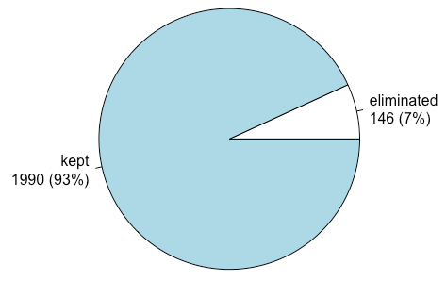
Input and quality control

Slide 5
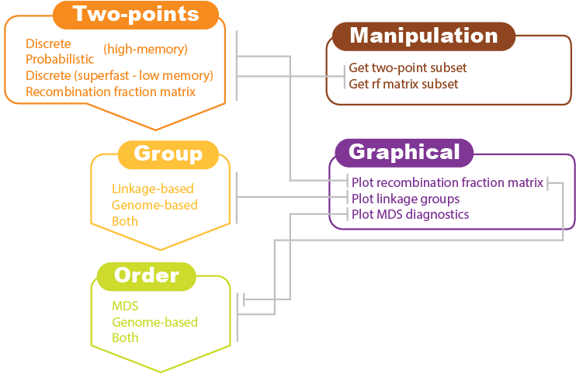
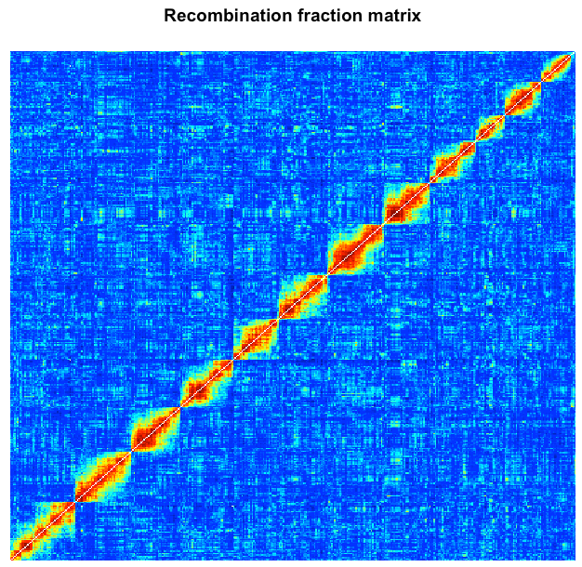
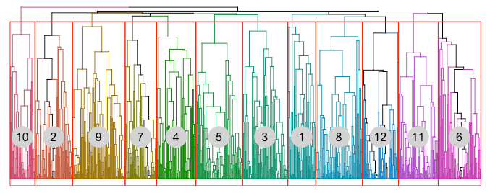
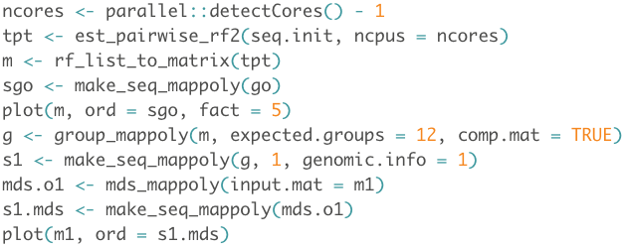
Two-points Rf calculation, grouping, and ordering

Slide 6
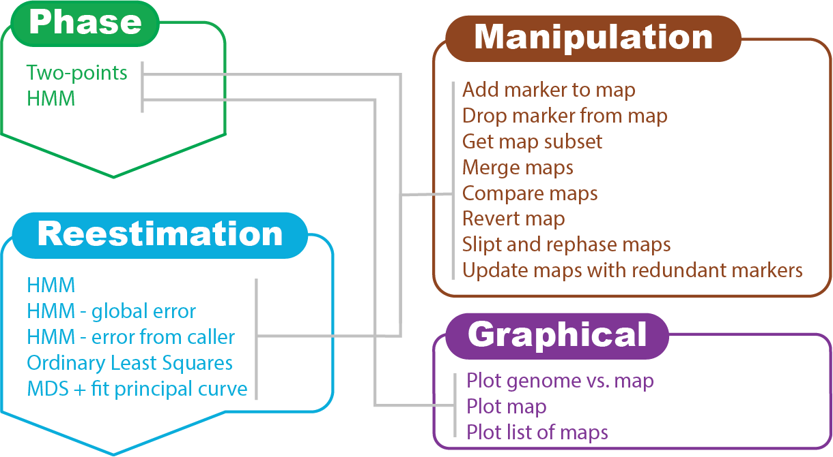
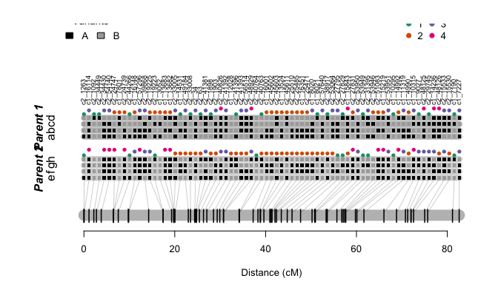
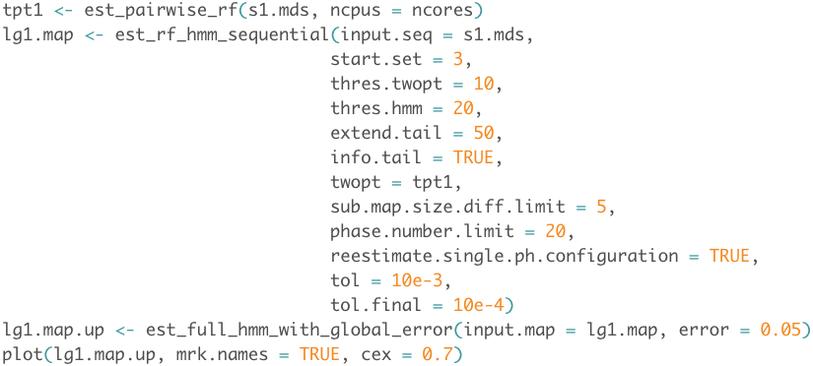
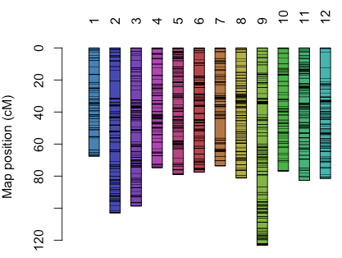
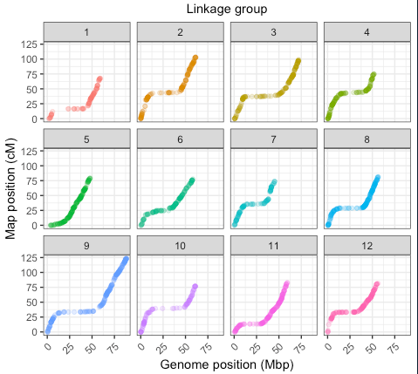
Phasing and multilocus re-estimation

Slide 7
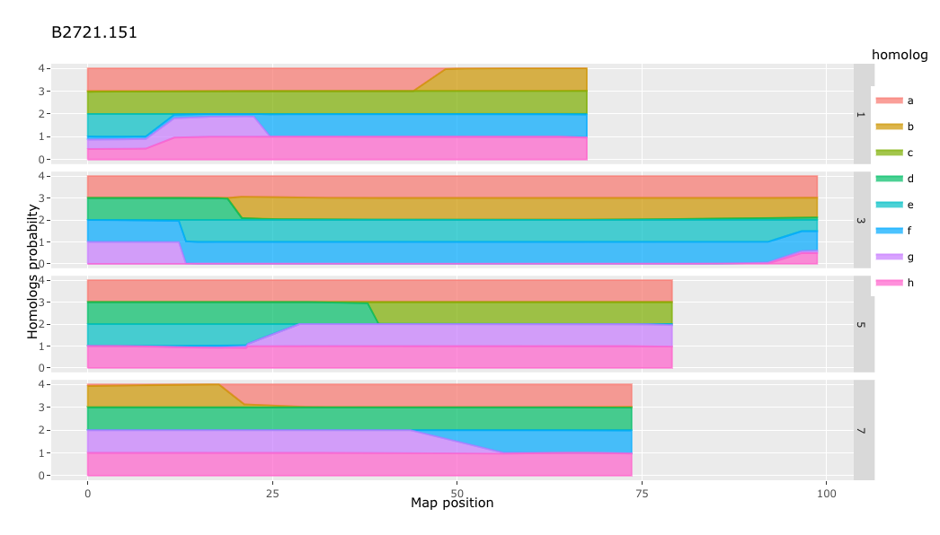
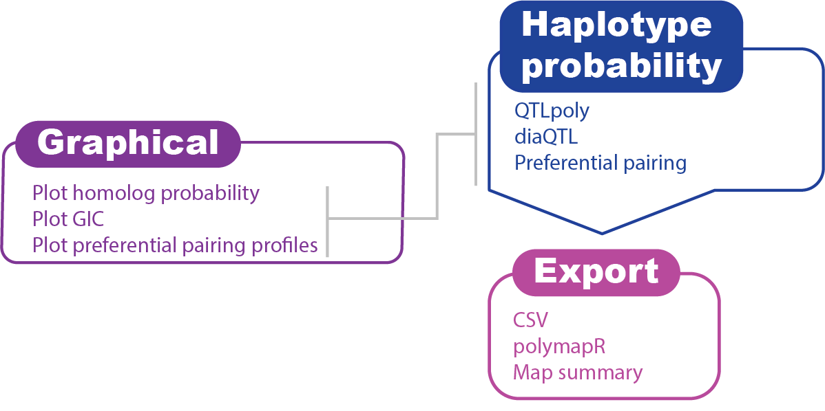
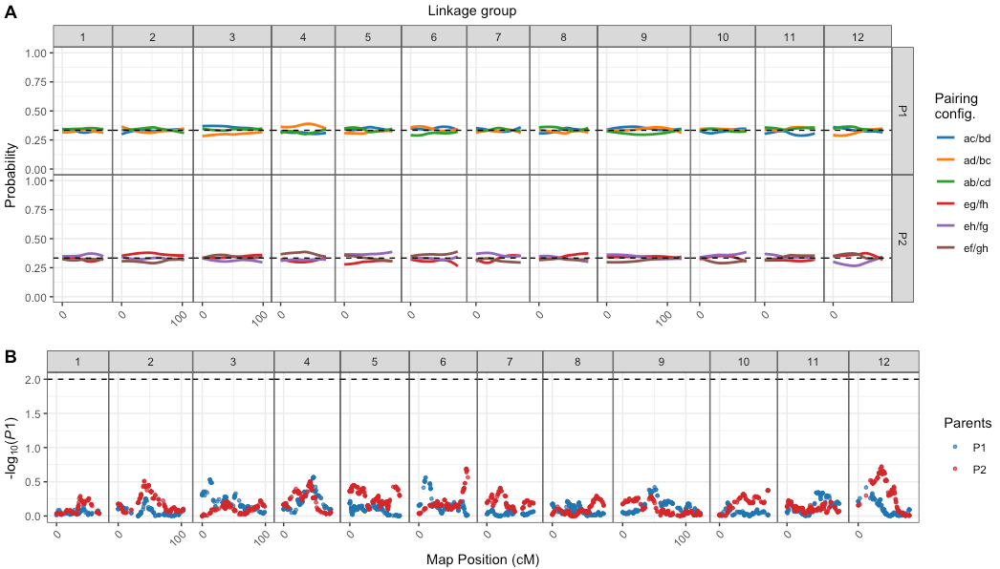
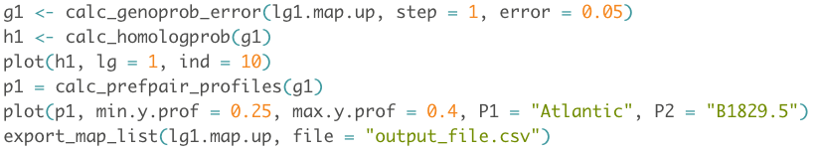
Haplotype probability and export

Slide 8
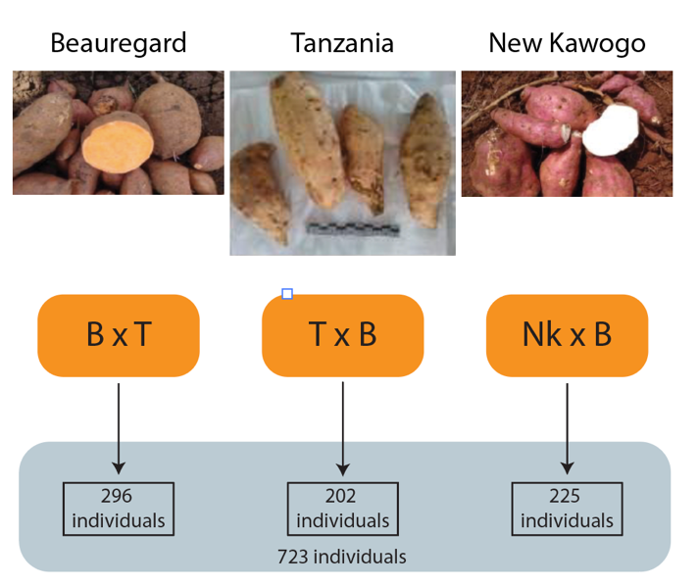
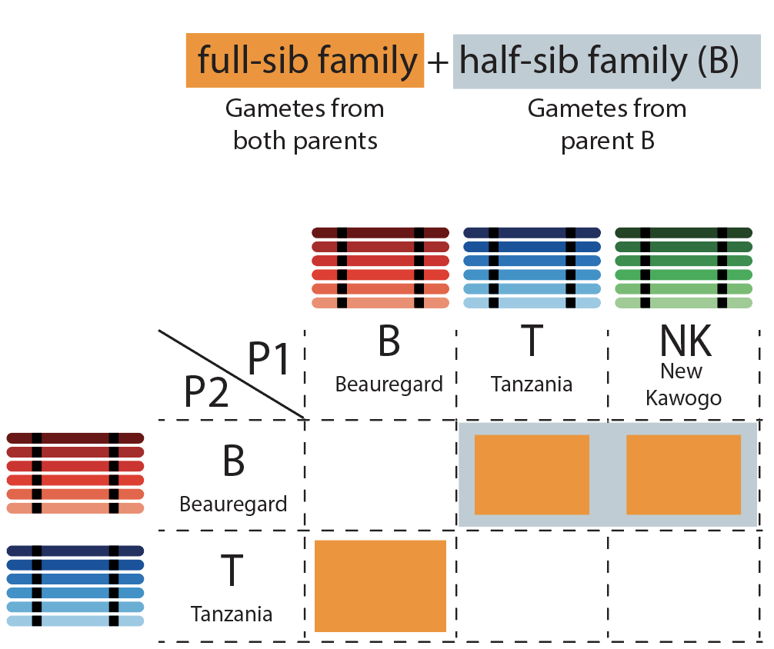

Case study: Three inter-connected hexaploid sweetpotato families
SweetGAINS project: Dr. Hugo Campos (CIP) and Dr. Craig Yencho (NCSU)
Parents: Beauregard, Tanzania and New Kawogo
Genotyping: GBS 28220 markers
Population: 723 individuals
Multiparental map based on connected families: can be used as input to PolyOrigin and other algorithms: will be available soon.

Slide 9
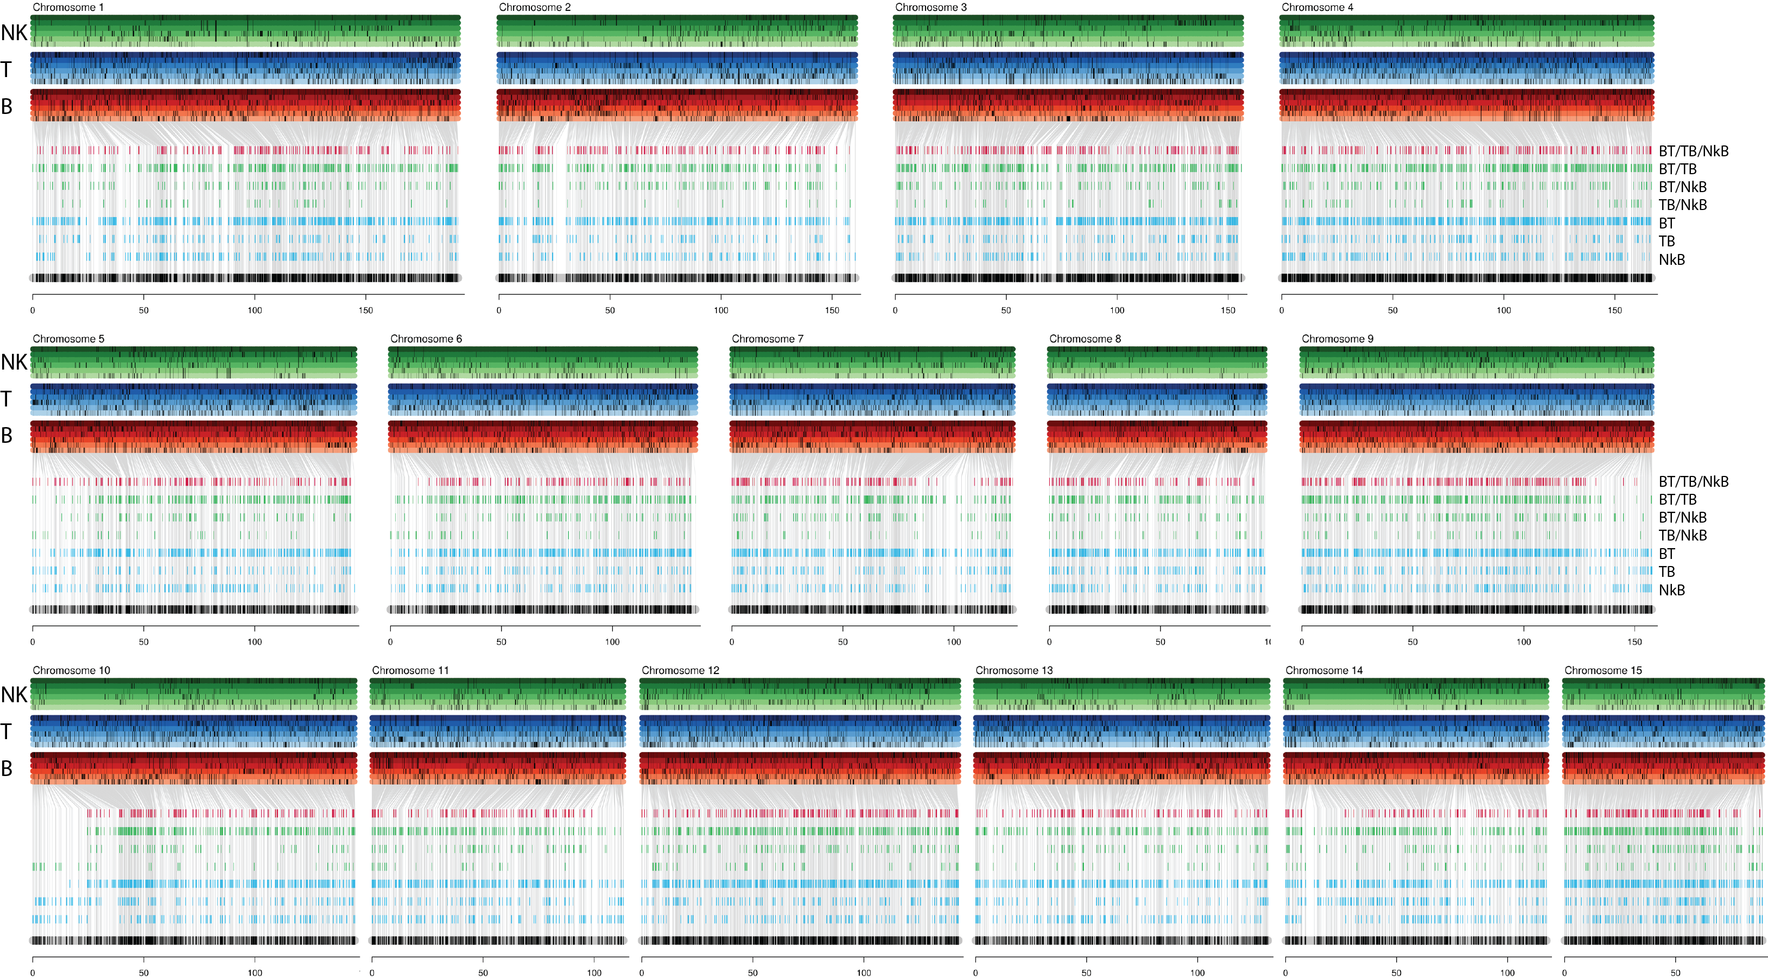
BT-TB-NKB genetic linkage map

Slide 10
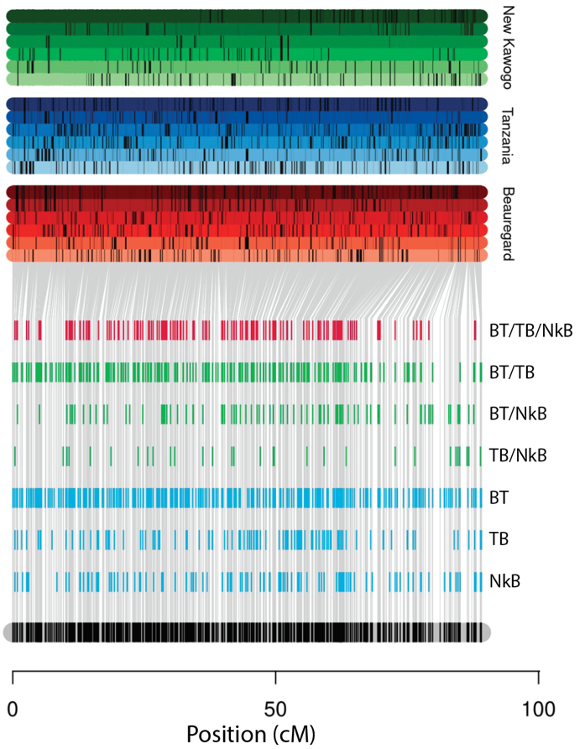
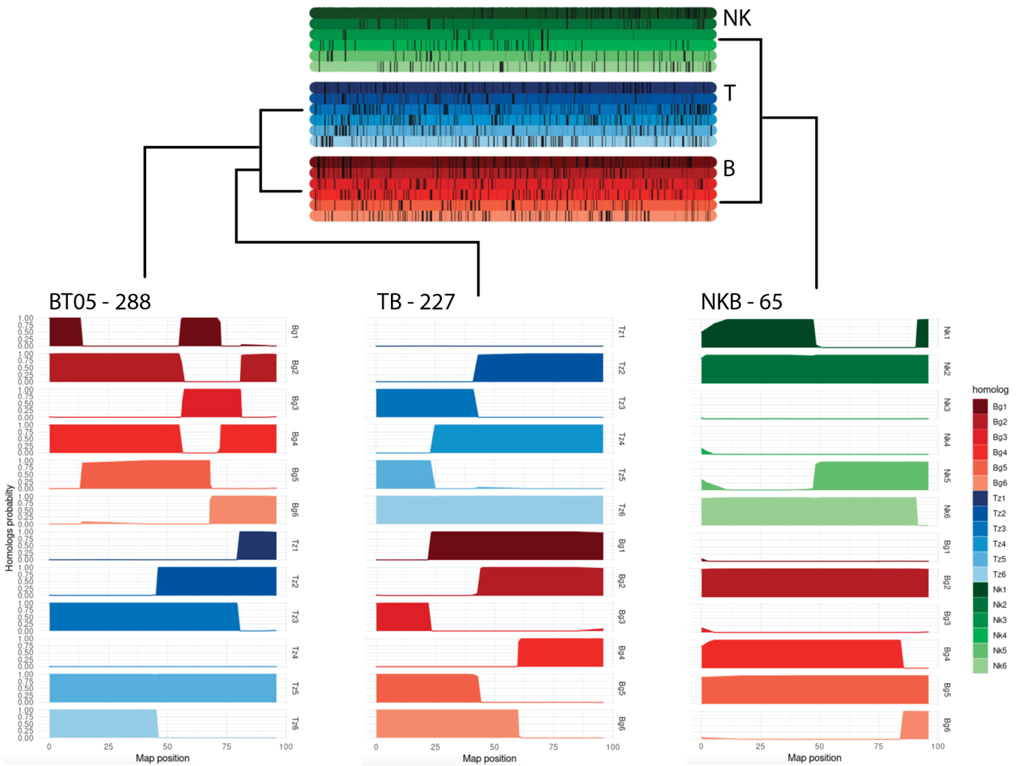
Haplotyping in BT-TB-NKB – Chromosome 15

Slide 11
Code demonstration

Slide 12
QTL mapping in polyploids
QTL mapping
- Genotypic variation → Phenotypic variation
- How to detect signals of those associations?
Polyploidy
Imposes challenges to genetic mapping
More alleles, many possible genotypes
Thus, many parameters to be estimated in the model

Slide 13
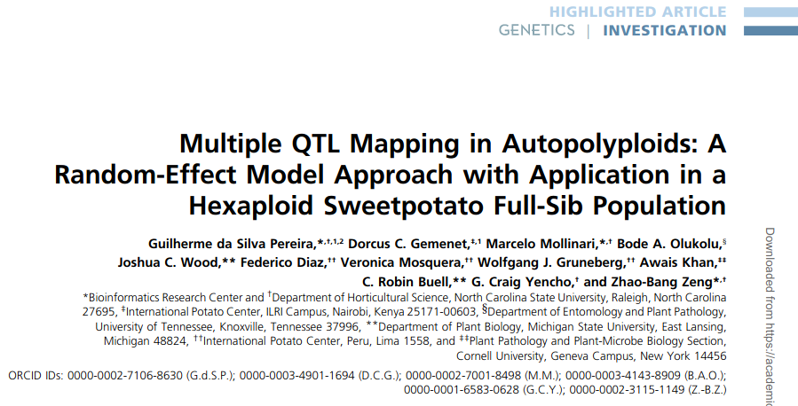
How to solve the n<<p problem?
Pereira et al., 2020. Multiple QTL Mapping in Autopolyploids: A Random-Effect Model Approach with Application in a Hexaploid Sweetpotato Full-Sib Population, Genetics, v. 215, 3.
https://doi.org/10.1534/genetics.120.303080

Slide 14
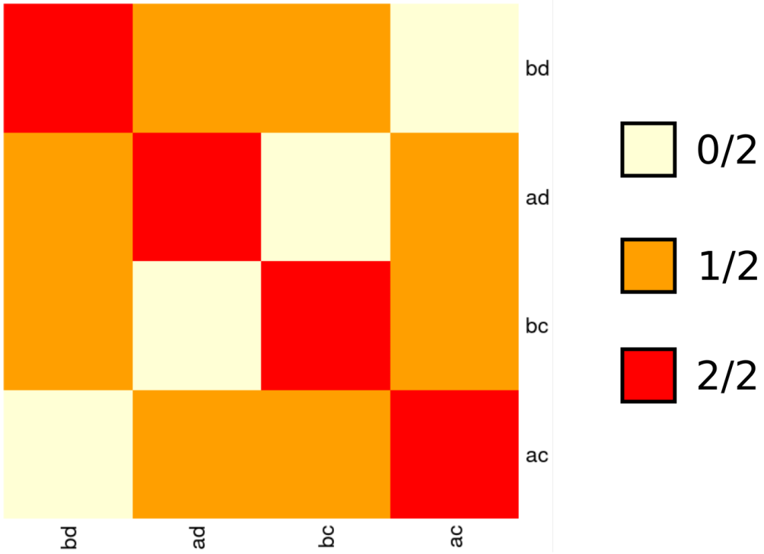
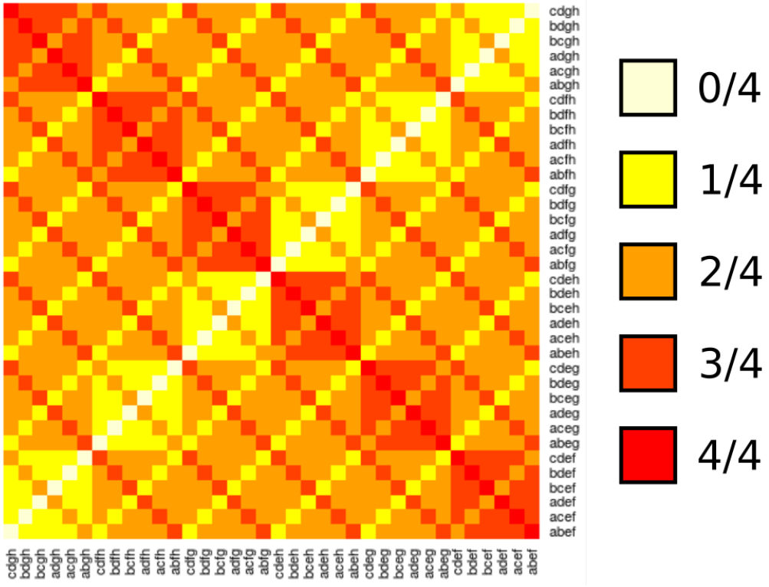
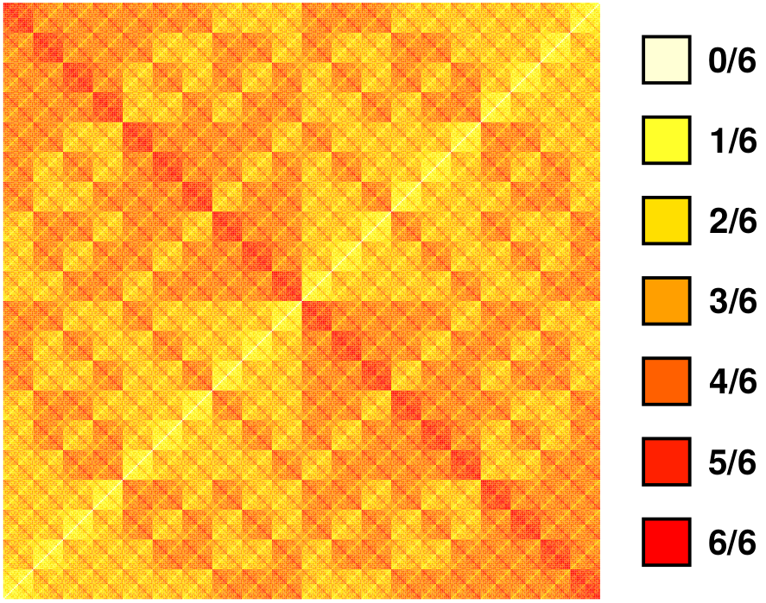
Expected relationship matrices
Expected genomic relationship matrix between full-sibs at any single genomic position
Diploid
Tetraploid
Hexaploid

Slide 15

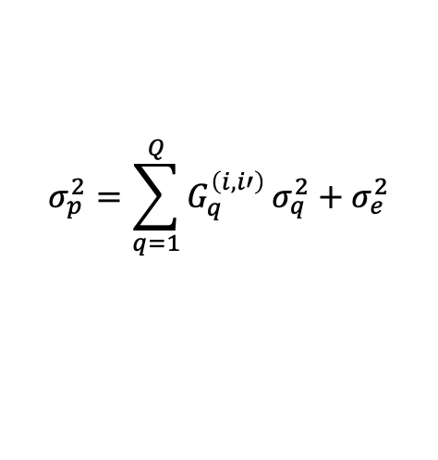
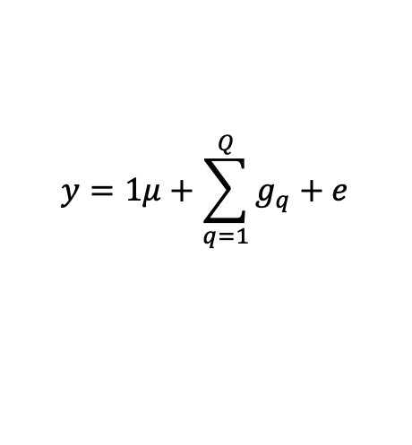
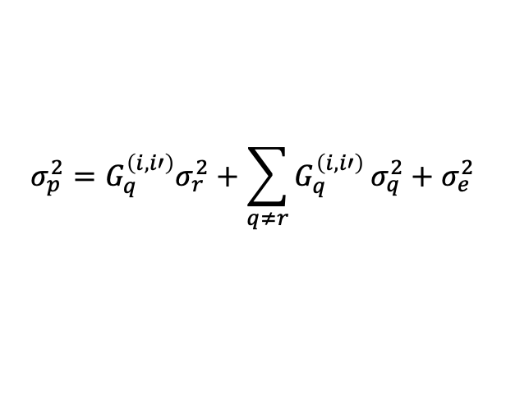
How to solve the n<<p problem?
Phenotypic data → mean and variance
Model selection algorithm:
1. A model starts with no QTL
2. Forward search adds one QTL at a time (if significant)
3. Model optimization:
3.1 Re-evaluate every QTL conditional to the others
3.2 Backward elimination of QTL with no significant effect
3.3 Position refining: updates QTL positions
$$y=1μ+\sum_{q=1}^{Q}{g_{q}}+e$$
$$σ_{p}^{2}=σ_{e}^{2}$$
$$σ_{p}^{2}=\sum_{q=1}^{Q}{G_{q}^{\left(i,i′\right)}}σ_{q}^{2}+σ_{e}^{2}$$
$$σ_{p}^{2}=G_{q}^{\left(i,i′\right)}σ_{r}^{2}+\sum_{q≠r}{G_{q}^{\left(i,i′\right)}}σ_{q}^{2}+σ_{e}^{2}$$

Slide 16
Perspectives
Extension to multi-parental populations
Multivariate QTL mapping
Integration with other model structures (model selection/GS)

Slide 17

Code demonstration
Download example files (SCRI repository)
https://github.com/mmollina/SCRI
Open
Install and load packages: mappoly and qtlpoly
Open the script: qtlpoly_startguide.R

Slide 18












Project Members

Slide 19























Other Collaborators
Neuhouse Farms
Woolf Roses L.L.C.

